Slide 1
ILLINOIS JUDICIAL BRANCH
PUBLIC RELATIONS PLAN
PRETRIAL IMPLEMENTATION TASK FORCE
DRAFTED BY THE ILLIONIS JUDICIAL CONFERENCE
PUBLIC RELATIONS TASK FORCE
Town Hall|Thursday, June 23
JUNE 2022

Slide 2
Please submit questions via the Zoom chat or email to pretrialtaskforce@illinoiscourts.gov
Housekeeping
Please keep yourself muted to limit background noise. This session is being recorded and will be posted on the website.
Anyone disrupting the Town Hall will be removed.

Slide 3
Welcome
Introduction
Hon. Robbin Stuckert, Chair, Illinois Supreme Court Pretrial Implementation Task Force
Judge Stuckert is the Chair of the Illinois Supreme Court Pretrial Implementation Task Force after previously leading the Supreme Court Commission on Pretrial Practices. She served as a trial court judge for 20 years and retired from the bench in 2021.

Slide 4
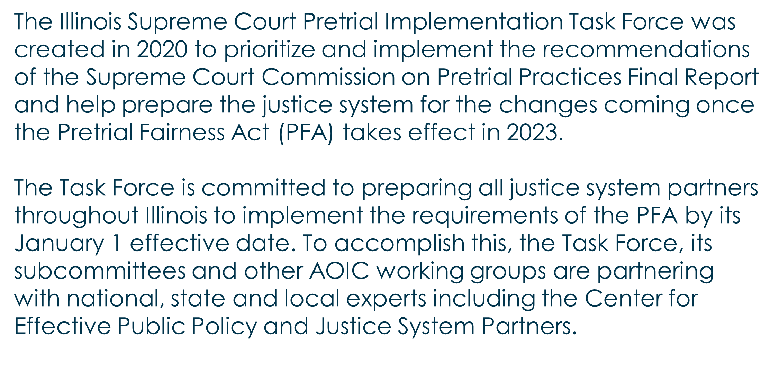
Role of the task force
Pretrial Implementation Task Force

Slide 5
Pretrial Implementation Task Force
Subcommittees
The 6 subcommittees are made up of over 100 members from around the state and include:
Judges
Sheriffs
Police Chiefs
State’s Attorneys
Public Defenders
Circuit Clerks
Pretrial Officers
Domestic Violence Advocates
County Board Members
Victims’ Rights Advocates
Community members with lived experience in the pretrial system
Trial Court Administrators
Researchers
Legislators
Behavioral Health and Substance Abuse Groups
Community-based Advocates

Slide 6
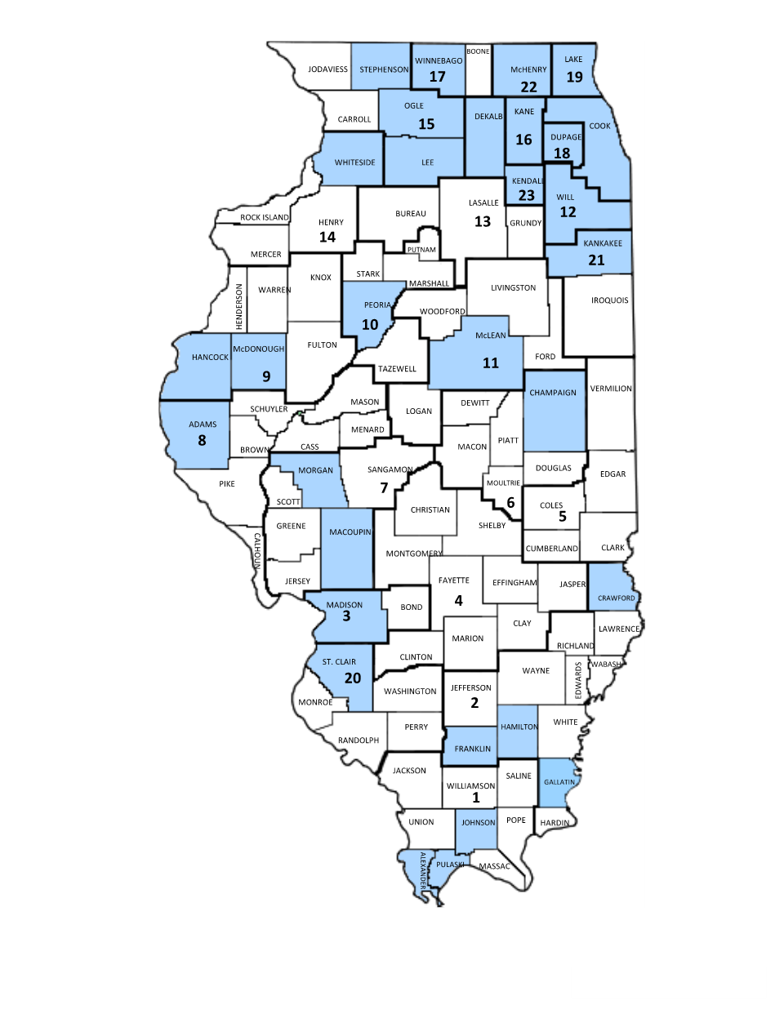
Pretrial Implementation Task Force
Subcommittee membership location by county (31 counties)

Slide 7
Guidelines
Task Force Subcommittees
The purpose of the PFA Guidelines Subcommittee is to develop a model process, guidelines, and related resources for counties to use to implement the Pretrial Fairness Act.
Pilot Sites -
Kane, Hancock, McDonough, Gallatin, Franklin counties
The purpose of the Pilot Sites Subcommittee is to identify and provide technical assistance to sites to support their implementation of the PFA, and to share their tools, templates and experience with other jurisdictions so that all Illinois counties are prepared to fully implement the provisions of the PFA in advance of the 1/1/23 effective date.
Education
The Education Subcommittee shall develop a comprehensive Education Plan (Plan) to support the implementation of the Pretrial Fairness Act (PFA) effective January 1, 2023.

Slide 8
Task Force Subcommittees
Communications
The purpose of the Communications Subcommittee is to develop a plan and resources to educate diverse internal and external audiences about the PFA—including the legal and evidence-based practices that will support successful implementation of the law—and the AOIC’s plans for PFA implementation.
Assessments
The purpose of the Pretrial Assessment Tools subcommittee is to develop and approve guidelines for scoring and using assessment tools related to the Pretrial Fairness Act (PFA).
Legislative
The purpose of the Legislative Subcommittee is to review pretrial-related legislation for possible improvements and clarity.

Slide 9
Vision:
Office of Statewide Pretrial Services
Promoting pretrial justice and community safety throughout Illinois
Mission:
To assist in the administration of justice and to promote community safety by ensuring fairness and equality in the pretrial process.
Core Values:
Community Safety, Equal Justice, Equity, Integrity, Respect, Diversity and Inclusion, Collaboration

Slide 10
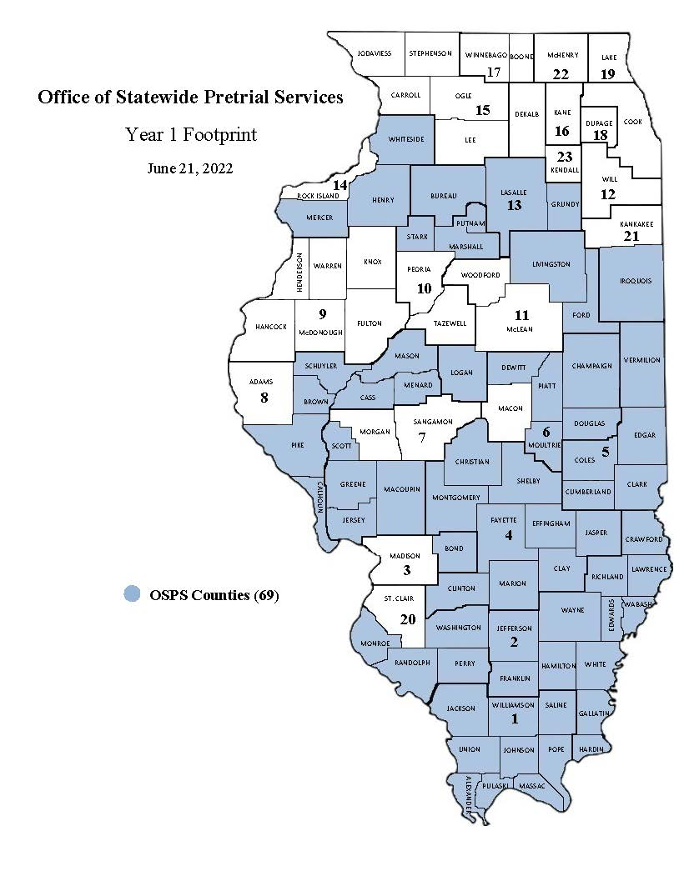
Year 1 Footprint: 69 counties
Office of Statewide Pretrial Services

Slide 11
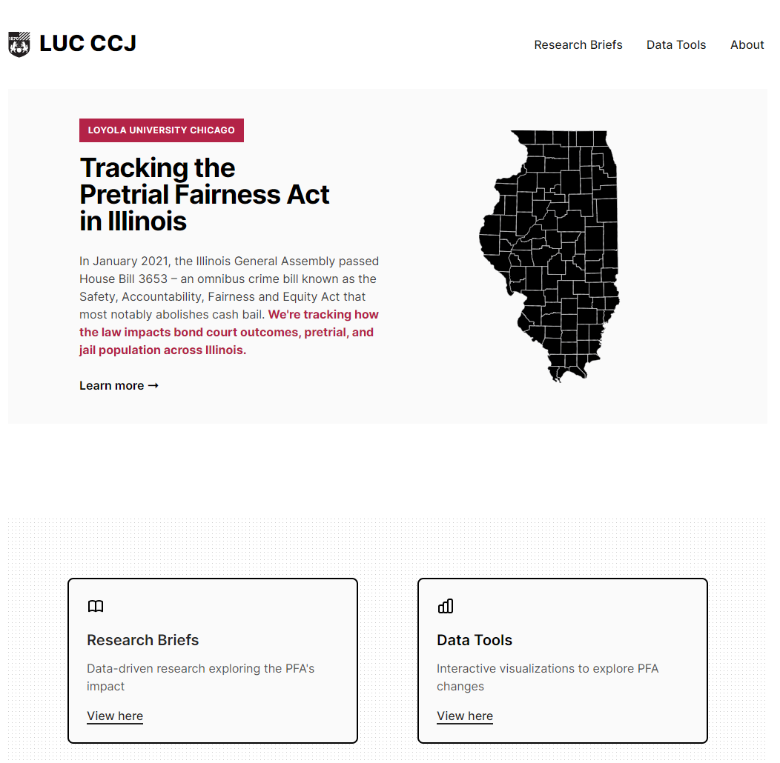
Website:
Loyola University Prof. Don Stemen
Loyolaccj.org/pfa
Notes:
Click to show map

Slide 12
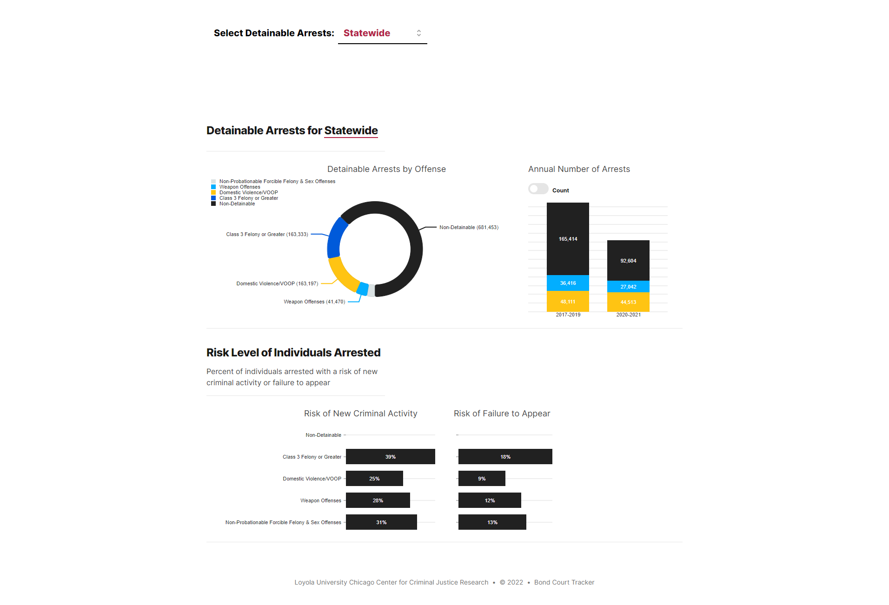
Website:
Loyola University Prof. Don Stemen
Loyolaccj.org/pfa
Notes:
Click to show map

Slide 13
The Task Force will publish the work of the Guidelines Subcommittee on an ongoing basis ahead of the Jan. 1 effective date. • Citations/release from police custody • First appearance • Conditions of release • Detention hearings • Modification of conditions/Revocation
Releasing Guidance on the PFA
Notes:
Click to show map

Slide 14
Implementation guidance from the three Pilot Sites
Releasing Guidance on the PFA
The work will be posted on the Task Force webpage at www.illinoiscourts.gov/courts/additional-resources/pretrial-implementation-task-force/.
Notes:
Click to show map

Slide 15
July 21, Noon
Upcoming Town Halls
August 18, Noon
September 15, Noon
All meetings will be held via Zoom unless otherwise noted.

Slide 16
Questions?
Website: www.illinoiscourts.gov/courts/additional-resources/pretrial-implementation-task-force/
Email: pretrialtaskforce@illinoiscourts.gov

